Slide 1
JLPT orientation
York University, 2024

Slide 2
The Japanese Language Proficiency Test (JLPT)
Please read
Instructions for proctors
How to fill in the proctor’s report
very carefully.

Slide 3
Proctor’s job
Ensure a smooth testing process by avoiding any misconduct. (check what counts as misconduct on the manual).
Collect all answer sheets and other materials at the end of testing so that no materials go missing or are taken away accidently.

Slide 4
Handling of Test Materials
A great deal of care should be taken to prevent the loss or disclosure of question booklets.
Question booklets should not be seen by anyone other than the administrators.
The administrators must not transcribe or make any photographic copies of the test.
(page 5)

Slide 5
Important Notice
The question booklets will not be disclosed.
All the question booklets (including those which are not used) and the listening test CDs allocated for each test room are collected and returned
None of the examinees leaves with question booklets either accidentally or intentionally
No examinees are copying test questions and/or answers on the test voucher and taking it outside the test room.

Slide 6
Misconduct
Examinees who have attempted to commit or have committed any of the misconduct listed below will have their test results invalidated for all test sections.
a) An examinee whose mobile phone or watch alarm sounds or vibrates during the test;
b) An examinee who provides others with answers, or who obtains answers from other examinees, or who uses a dictionary, textbook, reference book, crib sheet, earphone, mobile phone, or who writes answers in advance on their desk or writing equipment;
c) An examinee who is found to be taking the test for someone else, or to have asked someone to take the test on their behalf, or an examinee whose identity could not be verified due to the use of a fraudulent ID or other such reason;
d) An examinee who fails to follow the proctor’s instructions;
e) An examinee who takes the question booklets and/or answer sheets outside the test room with them, takes photos of the question booklets and/or answer sheets, or takes the contents of the question booklets and/or answer sheets outside the test room by copying them or recording them;
f) An examinee who disturbs other examinees in any way;
g) An examinee who shares the test contents and answers, photos of the question booklets and/or answer sheets, or audio content of the listening test via the Internet or any other means of communication with any third party, and vice versa;
h) An examinee who cooperates with someone committing misconduct (b), (c), (e), (f) or (g).

Slide 7
7:00 am: Registration starts
Assistants
One assistant from each lecture hall(two from each level) will be at the registration desk.

Slide 8
Before the test
Assistants
Help set up
Post signs on campus (washroom, lecture hall)
Set up the registration desk (one from each classroom)
Set up the lecture hall (post registration numbers, post schedule, post notice about misconduct)
Help proctors check CD for listening.
Bring stationary to the lecture hall (make sure there are sufficient supplies)

Slide 9
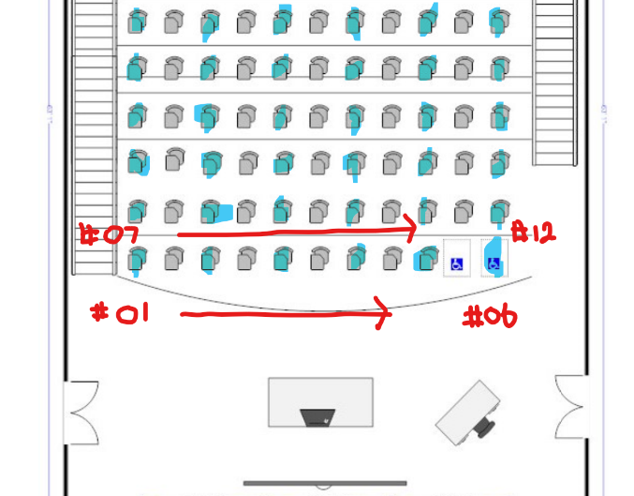
Before the test (page 5)
Proctors
Assign assistants to post registration numbers on desks (arranged in order, for easy collection)
Check the sound quality of the CDs
Post the time schedule & notice about the misconduct

Slide 10
8:00- Entering the room (page 10) Check test vouchers and IDs upon arrival
Examinees
Proctors & Assistants
Take the seat with assigned registration number
Place voucher & ID on the desk
Place black pencils, erasers, and a watch
No Water bottles(?)
Eye glass cases, etc.
Ask them to leave their belongings at the front of the lecture hall.
Ask them to turn off their cell phones.
Read the Instructions (Page 60)
“Please take the seat with …“
“Please put your voucher …”
“The only items …”
Lend pencils and erasers if necessary

Slide 11
10:00-10:10 Orientation via Zoom
Assistants
Proctors
Help all the examinees settle in their seats (please make sure they sit at the correct seat)
Prepare to distribute test papers and answer sheets
Make sure that your zoom link is working.
Receive question booklets and answer sheets for the first section

Slide 12
10:10 –10:25 (ID check &) Instructions
Assistants
Proctors
Check ID and voucher for each examinee upon entering (only ofr the first section). They need to be in the correct seat.
Prepare to distribute test papers and answer sheets
Read the instructions with aloud (page 10 continued)
“The only items …”
“An examinee whose mobile phone sounds…”
“Do not use ball-point pen…”
“Do not leave the room…”
“If you do not attend the…”

Slide 13
Distributing Question booklets and Answer Sheets (page 11)
Assistants
Proctors
Hand out the answer sheets first (set of 2 or 3).
Hand out the question booklets.
Walk around to ensure that examinees are filling out the correct bubbles.
“We will now hand out the answer sheets”
“Write your registration #, name and date of birth (not today’s date) on the answer sheet.”
“The question booklet consists of ___ pages. “
Examinees are not allowed to take the question booklets out.
They are not allowed to write down the questions/answers on the test voucher

Slide 14
10:30 – Starting the Test (Page 12)
“You have ____minutes. The test begins at ___ and will end at ____.
“You may now begin”
(Latecomers may come in up to 10 minutes after the test starts.)

Slide 15
10:40 (10 minutes after test start) Check absentees
Assistants
Proctors
Write a large “X” on absentee’s answer sheet (and registration # of that absentee)
(Write registration # on question booklets)
Collect and count papers
(the total # should match the # of absentees on the report)
Write the absentee’s registration # on Proctor’s Report
Count the # of registered, those who attended, and absentees.

Slide 16
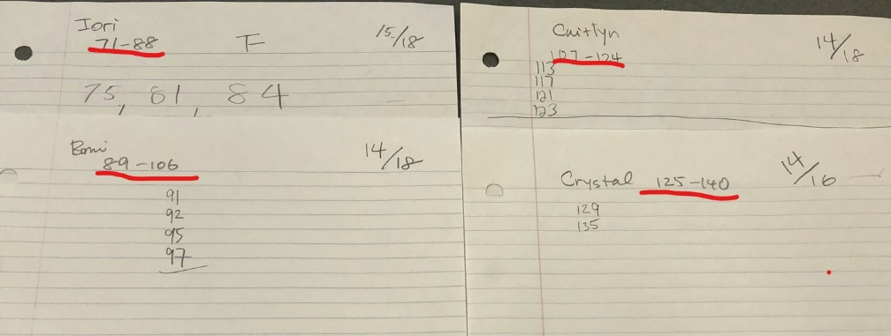
Sample: How to check absentees
70 registration – 13 absentees = 57 answer sheets
Four assistants for 70 registered examinees
Assistant 1: #71-88 (n=18) 3 absentees
Assistant 2: #89-106 (n=18) 4 absentees
Assistant 3: #107-124 (n=18) 4 absentees
Assistant 4: #125-140 (n=16) 2 absentees

Slide 17
10:40 (10 minutes after test start) Proctors: Record the # on Proctor’s Report

Slide 18
10:40 (10 minutes after test start) Proctors: Record the # on Proctor’s Report

Slide 19
Next: Identification
Assistants
Proctors (assistants)
Verify the identity of each examinee using their ID card.
Verify they are in the correct seat.
Make sure that examinees correctly write their registration #, name and date of birth on the answer sheet.
“there are 5 minutes left”
Walk quietly around the room to prevent cheating

Slide 20
Notice of time remaining (page 13)
Proctors (assistants)
“there are 5 minutes left”
“Time is up. The test is over”
Walk quietly around the room to prevent cheating

Slide 21
Collecting (Page 64)
Proctors
Assistants
Make sure no answer sheets are missing except for those of absentees (check the missing number against Proctor’s report)
Put all the answer sheets and booklets (including those of absentees) into the pink envelope and return them to the head office.
Collect answer sheets
(put them in order of registration # and count them)
Collect Question Booklets
(count them)
Return the envelopes to the head office and bring back the next set of materials
Be sure to collect and verify the number of answer sheets first! Keep the extra answer sheets as they are.

Slide 22
At headquarters
Assistants
HQ manager
Count the answer sheets for each level. Check if the name, registration # and answers are marked correctly
Count the number of collected booklets and answer sheets. Make sure that the number matches what is written on the return envelope.
Organize the checked answer sheets and booklet according to the level.
Ensure that the counting process for each level proceeds smoothly
Prepare test materials for the following section.
Common Problems and Solutions!
Case 2 A completed answer sheet(s) is missing after the test.
-Check to see if the number of collected answer sheets entered on the envelope "Use for Answer Sheets" or "Use for Return of the Answer Sheets to the Japan Foundation" matches the actual number of answer sheets inside the envelope. (page 2)

Slide 23
Repeat the same procedure for the second session, grammar-reading N3, N4, & N5
N1& N2 will have two sessions (language knowledge and listening).

Slide 24
Test procedure for Listening
Repeat the same procedure.
Check absentees before staring CD.
Do not walk around the test room.
Unexpected Interruption During the Listening Test (page 18-)
consult the local head office
If necessary, re-administer the Listening section immediately

Slide 25
Unexpected Interruption During the Listening Test
* The entire Listening section is recorded on one CD. You do not need to change CDs during the test.
* If you need to stop the CD after pressing the Play (Start) button, always use the Pause button NOT the Stop button. However, if any examinees cannot hear the CD clearly during the sound check (Track No. 1), stop the CD using the Stop button. After adjusting the volume, press the Play (Start) button and restart the CD from the beginning of the sound check.
* During the test, a proctor (preferably, one who understands Japanese) should read the question booklet and the CD time chart and follow along with the track numbers and question numbers in case the proctor needs to replay a question following an unexpected interruption.

Slide 26
After the test – the test room
Assistants
Proctors
Remove signs posted on the desks, doors, and hallways.
Return the materials to the headquarters.
Remove listening CD from the player.
Shut down the computer.
Complete the Proctor’s report.
Your signature is required at the end of each test session + at the top of the report!

Slide 27
After the test – at headquarters
Assistants
Proctors (room A and B and accommodation together)
Help proctors count the number of collected booklets and answer sheets.
Help proctors count the answer sheets.
Put booklets and unused answer sheets in envelope(s) and store them in the box.
Return the boxes to Professor Ota’s office.
Check collected answer sheets. (number + order for each level)
Check the Proctor’s Report to ensure the missing ID numbers match with the ID numbers of the absentees reported.
Put the answer sheets (to be marked) in the yellow envelopes. Remember to include the answer sheets from those who were accommodated (N1, N2, N3, and N5). important! Label the envelope with the correct number.
Put the rest of the materials (booklets, unused answer sheets, extras, and CDs) back into the original envelopes and store them in the box.

Slide 28
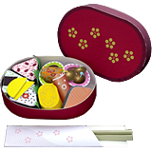
Finally
Assistants
Proctors
Ask your proctor if there is anything else to be done
Please help us clean up the room after we finish our lunch.
Submit your Proctor’s report (Do not forget to sign! There are many places for you to sign) and yellow envelopes to Professor Ota.
Enjoy delicious Obento lunch!
Last year, someone was unable to locate their vegetarian obento. Please refrain from selecting a vegetarian option unless you have arranged it with us in advance.

Slide 29
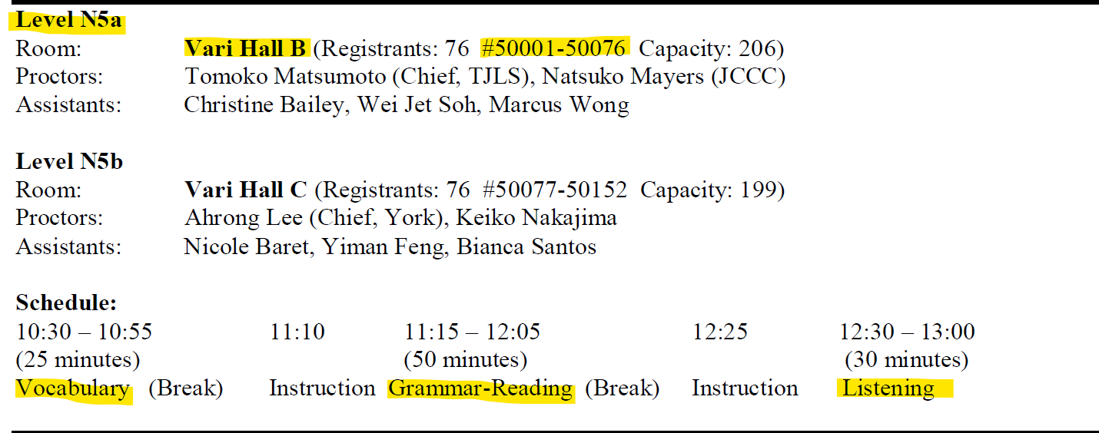
Know the information of your level
Please know your level, test room, # of registrants
Decide how many materials you would like to pack
76 (registrants) + 4 (extra)=80 or
76 (registrants)+ 14 (extra)=90

Slide 30
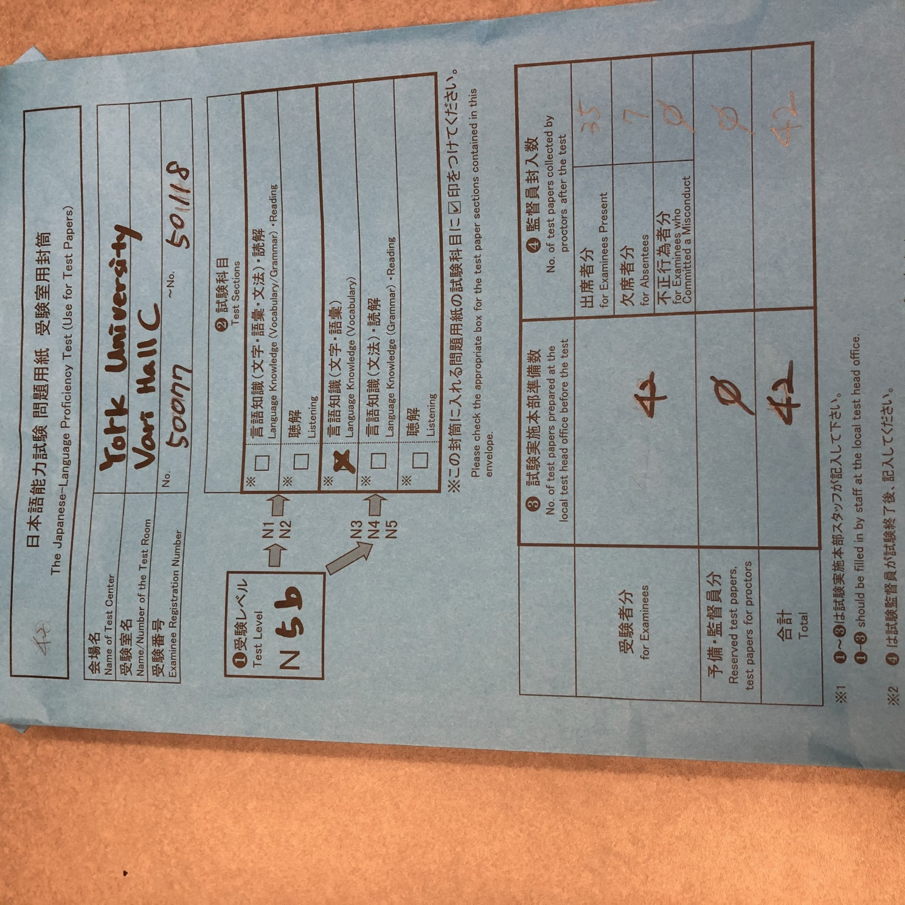
Label each envelope

Slide 31
Thank you so much
and
See you on Dec 1!

